Slide 1


Slide 2

Content:
December Email review
Newsletter stats

Slide 3
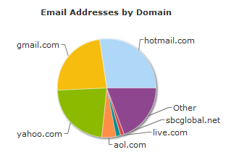
Top Domains - Inspin Newsletters
Yahoo, Hotmail & Gmail are the principal domains.

Slide 4
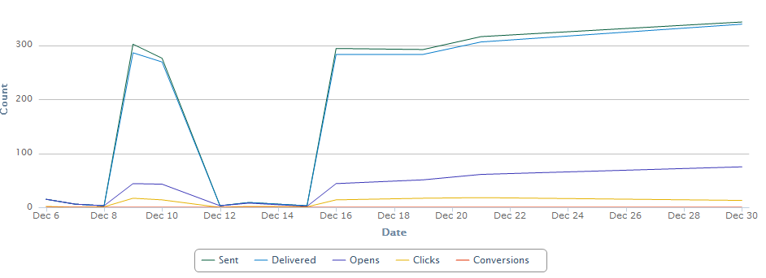
Message metrics - Inspin Newsletters

Slide 5


Clicks - Inspin Newsletters
Buttons and videos are the most clicked areas.
Share to Social and “Like us on Facebook” are under performing. As a team we need to review our social media strategy and once Share.Earn.Cash model has been finalized we can then start promoting it heavy on the emails.

Slide 6
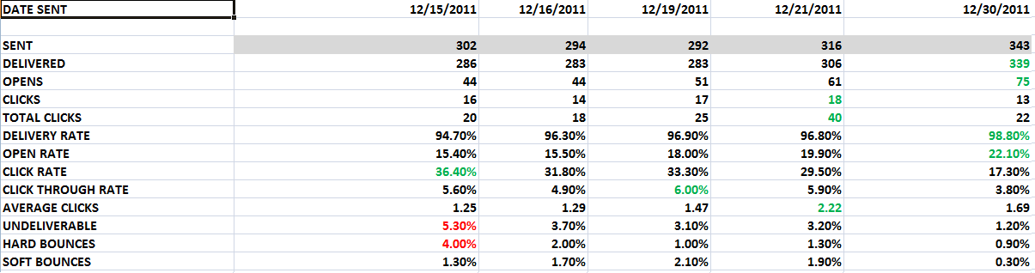
December newsletter stats - Inspin
Deliverability and open rates are now heading north.
This generally means recipients are expecting our emails, they are enjoying the content & lists are getting cleaner.

Slide 7
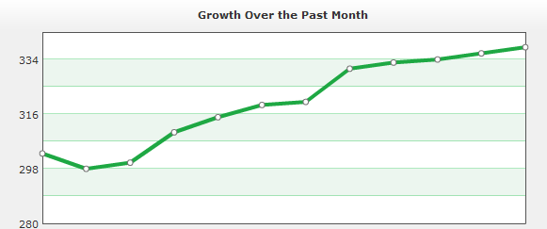
List growth - Inspin
Seeing steady growth on a daily basis. These recipients are added to the DB when registering on Inspin and been directly added to Bronto.

Slide 8
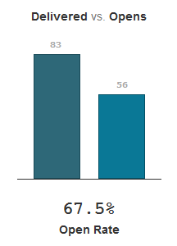
Welcome mailer - Inspin
Trigger - successful registration – December
Sent – 95
Delivered – 83
Unique Opens – 67.5%
CTR – 25%
Unsubscribe Rate – 2.1%
Soft bounce - 11
Hard bounce - 1
Very high open rate – way above industry standards.

Slide 9
Thank You
Scott Thompson
scott@vrbmarketing.com

